Slide 1
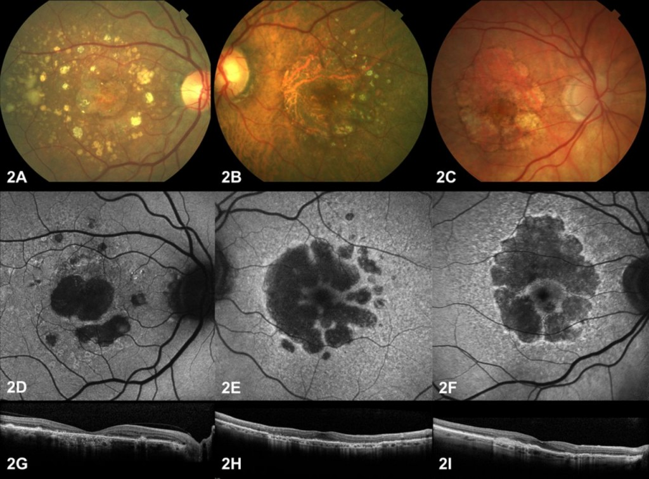
Retinal OCT Images
Selected_2

Slide 2
Member Team :
معتصم محمد رجب محمد 202000928
محمد على مصلح على 202000804
ايه رافت متولي 202000184
هنا محمد زين محمد 202001039
ياسمين حمدي عبده محمد 201900958
عماد مصطفي سراج الدين 202000580
مروة اسعد سعيد احمد 202000867

Slide 3

What was our process?
Import Libraries
Preprocessiong
01
04
02
Data Augmentation
03
Show Sample
Notes:
Notes to presenter:
What did you think at first?
What obstacles did you encounter along the way?
How did you overcome those obstacles?
What images can you add to support your process?
This SmartArt allows you add images and text to help outline your process. If a picture is worth a thousand words, then pictures and words should help you communicate this reflection on learning perfectly! You can always click on Insert>SmartArt to change this graphic or select the graphic and click on the Design contextual menu to change the colors.
Feel free to use more than one slide to reflect upon your process. It also helps to add some video of your process.

Slide 4
What was our process? Cont.
VGG16
Evaluate model
05
08
06
Evaluate model
07
inceptionv3

Slide 5

Purpose
Optical coherence tomography (OCT) and optical coherence tomography angiography (OCTA) are non-invasive imaging tests. They use light waves to take cross-section pictures of your retina.
We do automated detection of mild and multi-class diabetic eye diseases using deep learning.
The experiment conducted employing the top two pretrained convolutional neural network (CNN) models on ImageNet
Notes:
Notes to presenter:
What is your purpose for sharing this reflection?
Is it at the end of a unit or project?
Are you sharing this reflection, at the attainment of a learning goal you set for yourself?
Is it at the end of a course?
State your purpose for the reflection or even the purpose of the learning experience or learning goal. Be clear and be specific in stating your purpose.

Slide 6

Steps Of Project:
1. Import Libraries :
2. Preprocessing of Data
* Total Num of Images : 83484
* labels = ['CNV', 'DME', 'DRUSEN', 'NORMAL’]
3. Data Augmentation :
* For Train : “ rescale, shear_range, zoom_range, horizontal_flip, validation_split”
* Validation : “rescale”
* Test : “rescale”
* Split The Image file
Notes:
Notes to presenter:
Description of what you learned in your own words on one side.
Include information about the topic
Details about the topic will also be helpful here.
Tell the story of your learning experience. Just like a story there should always be a beginning, middle and an end.
On the other side, you can add a graphic that provides evidence of what you learned.
Feel free to use more than one slide to reflect upon your process. It also helps to add some video of your process.

Slide 7
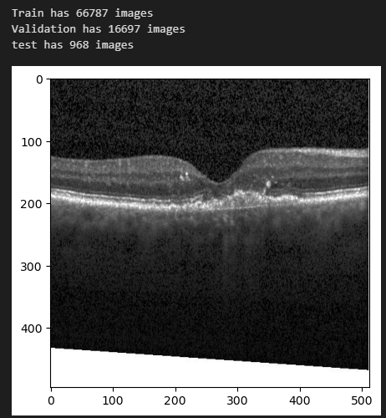
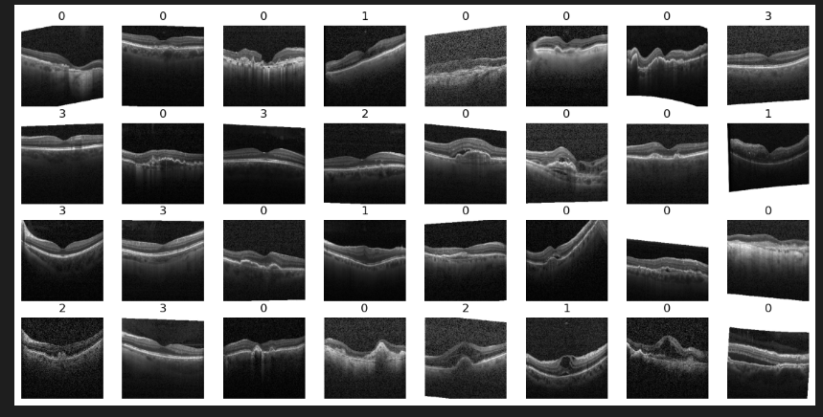
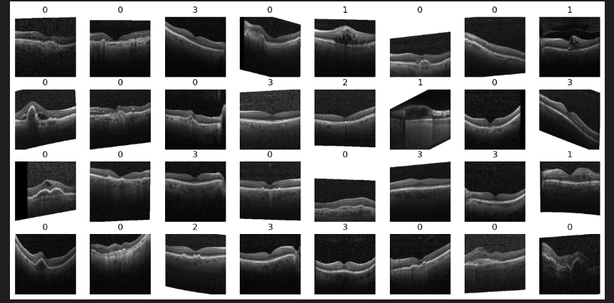
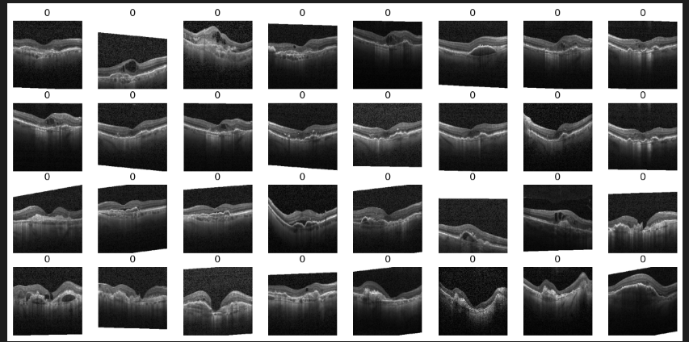
Steps of Project Cont.
4. Show Sample :

Slide 8
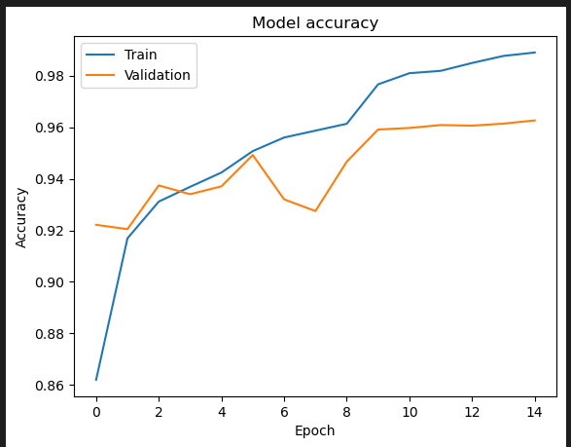
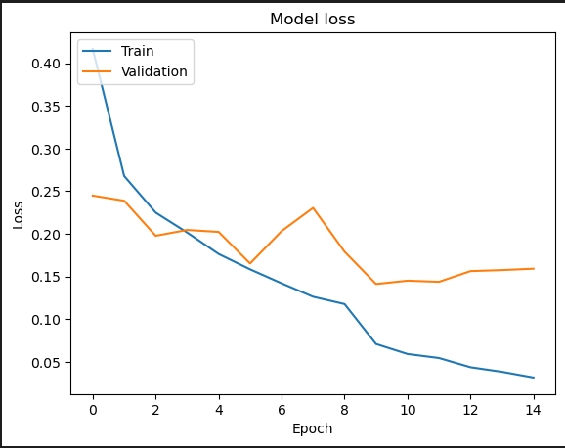
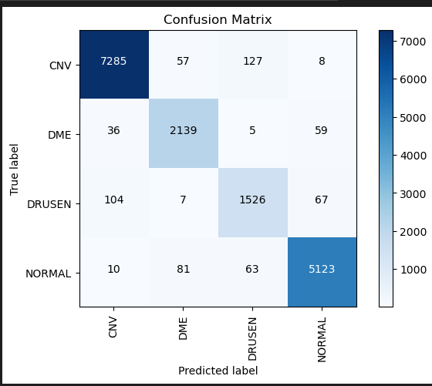
Built the Model VGG16 “Charts”

Slide 9
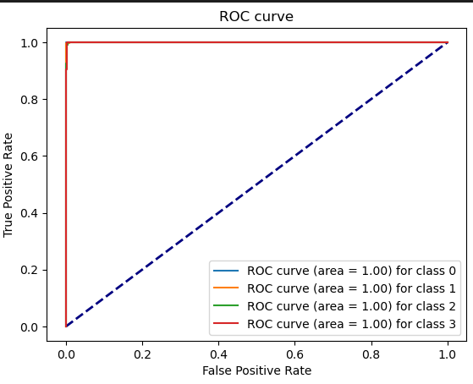
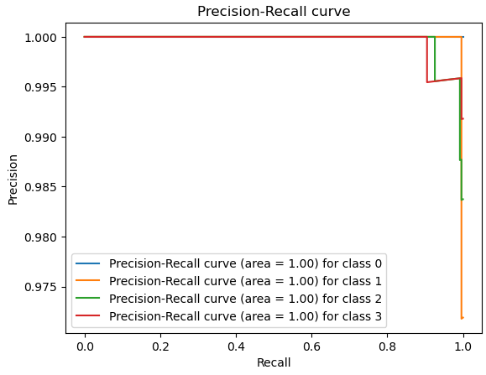
Built the Model VGG16 “Accuracy”

Slide 10
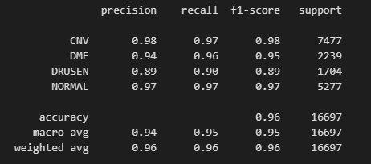
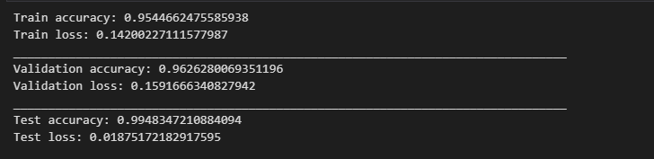
Precision, recall, f1-score, support
Evaluate train, validation and test

Slide 11
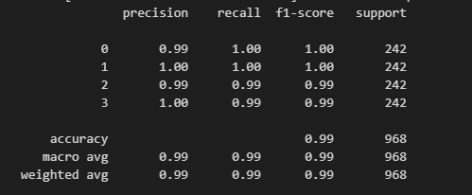
Evaluate the Third Model on the test data

Slide 12
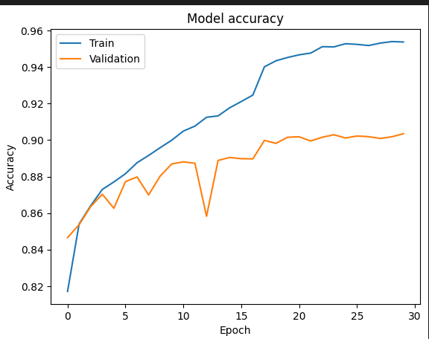
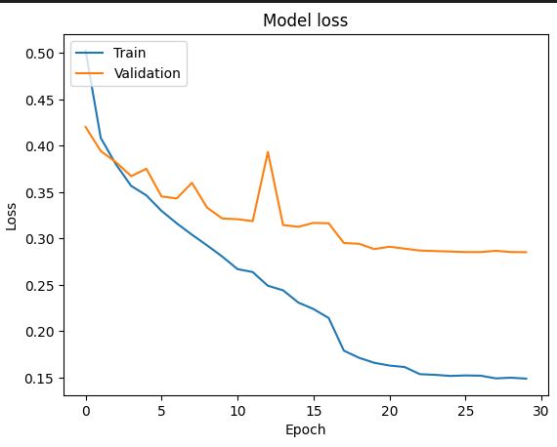
Built the Model inceptionV3 “Charts”

Slide 13
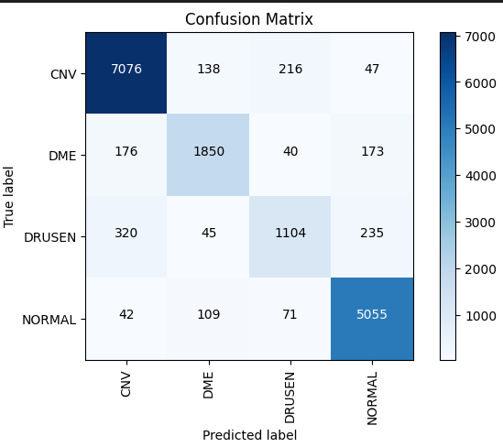
Confusion Matrix

Slide 14
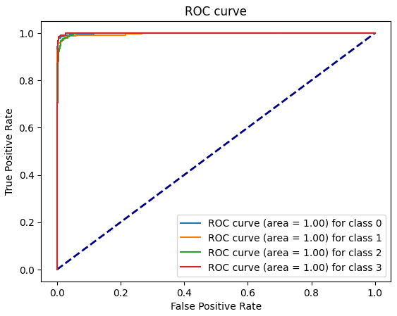
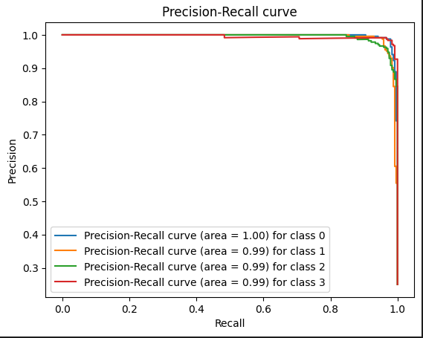
Calculate the Accuracy
ROC curve
Precision-Recall curve

Slide 15

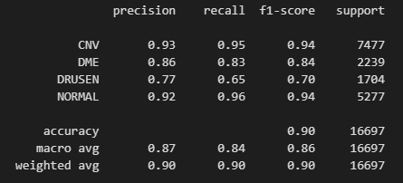
Calculate precision, recall, f1-score, support :

Slide 16
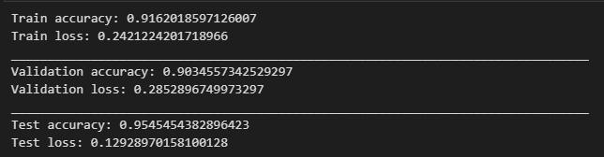
Evaluate train, validation and test generator :

Slide 17
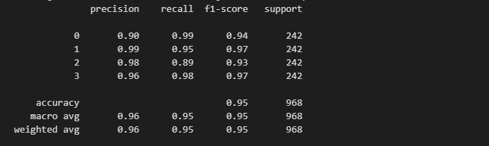
Evaluate the Third model on the Test Data:

Slide 18
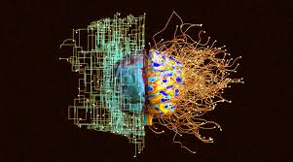
Thank You …

